Slide 1
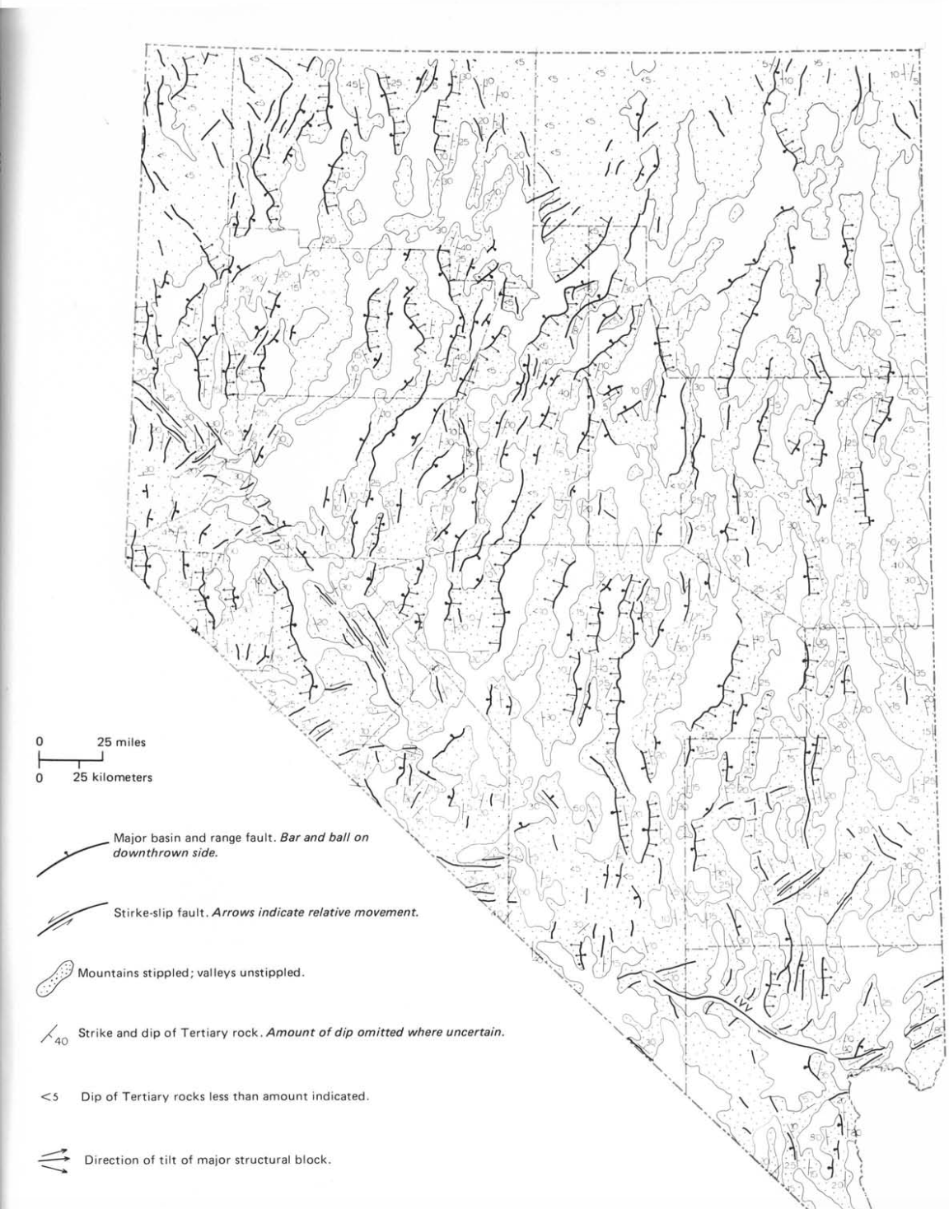
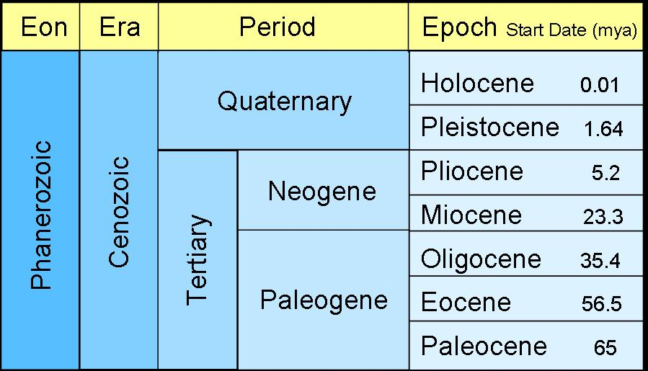
Geology of Nevada: A Discussion to Accompany the Geologic Map of Nevada (pg. 105-115)
John H. Stewart
Notes:
Present day basins and ranges formed during cenezoic tectonics
Describes overview and proof for cenezoic tectonics

Slide 2
Early/Mid Tertiary Faulting
Normal faulting visible in depositional layers but not overlaying layers
Folding bounded to 33-38 mya
Coarse conglomerate rocks at base of tertiary formations imply tectonics-related landslides
Broadly attributed to regional volcanics.
Notes:
Most relief attributed to widespread volcanics

Slide 3
Initiation of Extension
Ash-flows imply lack of relief during middle Tertiary → minimal regional-scale distortion yet
VS
Extension began ~ 17 mya
Notes:
Most relief attributed to widespread volcanics

Slide 4
Evidence for Extension
Transition from calc-alkali volcanic rocks to basaltic volcanic rocks (dated to ~ 17 mya)
Fault-controlled sedimentary basins date back to 11-13 mya
Notes:
Most relief attributed to widespread volcanics

Slide 5
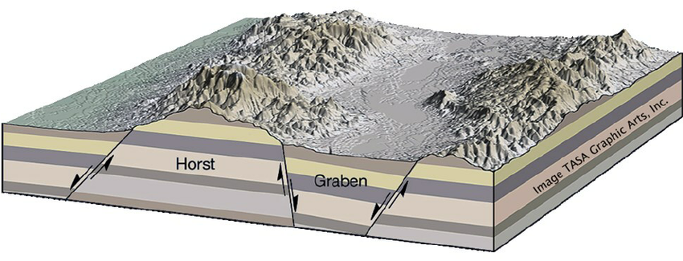
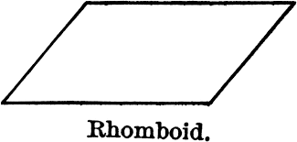
Basin & Range Structure Models
Structural blocks rotating along listic faults
(30-50% extension)
2. Horsts and grabens
(10-20% extension)
3. Upper crust fragmented by high-angle faults → rhomboid-shaped blocks
Notes:
Most relief attributed to widespread volcanics

Slide 6
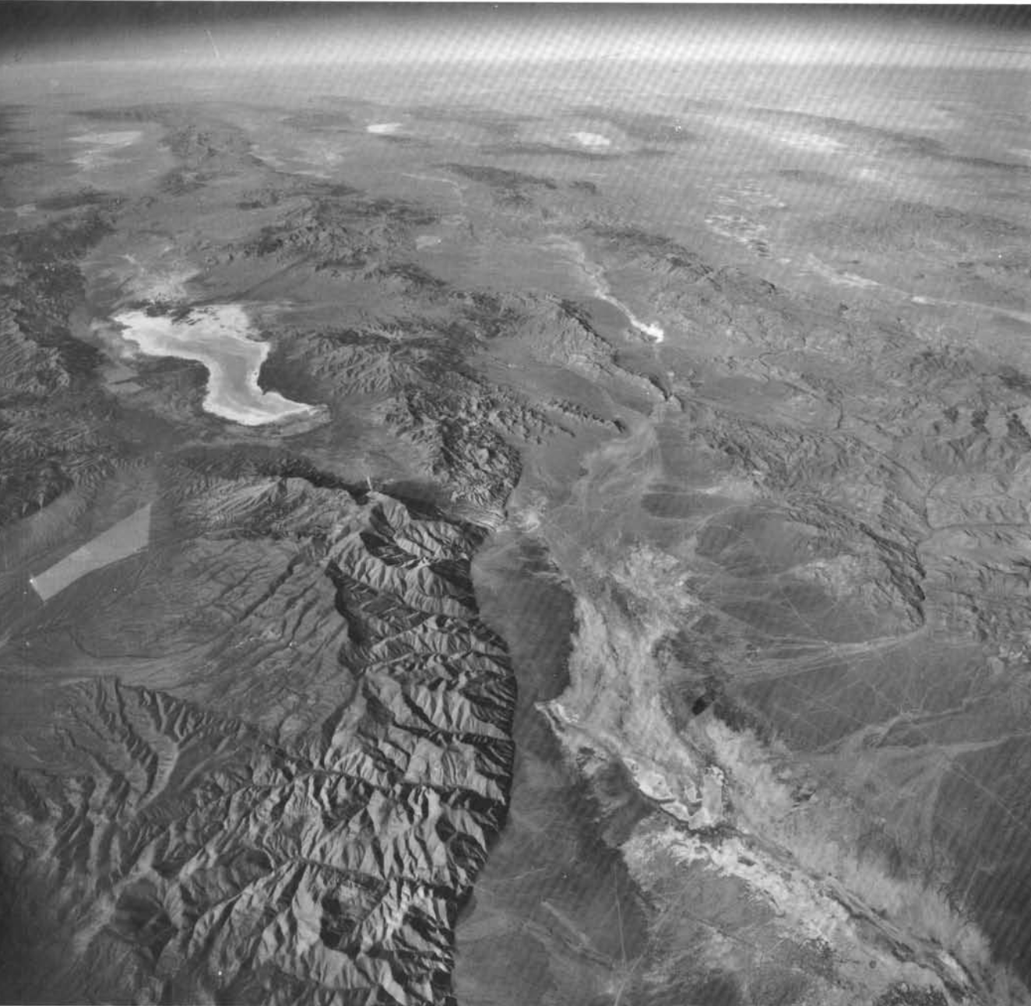
S-W

Slide 7
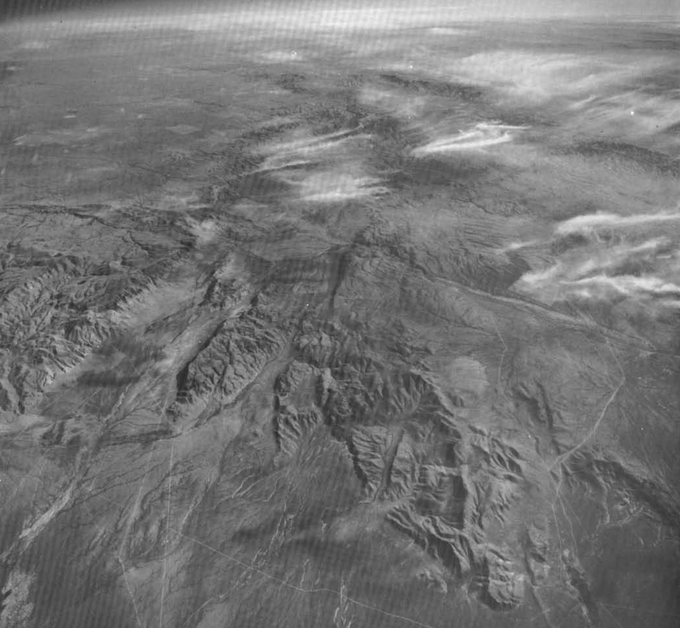
N-E

Slide 8
Drivers of Extension
Thrust faulting (stress accommodated by strike-slip and by pulling apart basin
2. Back-arc spreading
3. Subduction of East Pacific Rise
4. Mantle plumes
Notes:
Most relief attributed to widespread volcanics

